Slide 1
EM358x Family Introduction
David Egan / Thomas Barber
FAE Summer School, April 2013

Slide 2
Learning Objectives
In this session we are focused on the EM358x family of ZigBee SoCs
EM358x is an extension of the existing EM35x family.
Following this session you will be able to
Identify the right Silicon Labs ZigBee product for your customer’s design
Demonstrate the selling proposition for EM358x products
Position the EM358x versus competition
How?
By presenting the features of EM358x variants and what applications they enable
By discussing how Silicon Labs Ember ZigBee tools and software work to provide a market leading ZigBee solution
By dealing with the main competition head-on

Slide 3
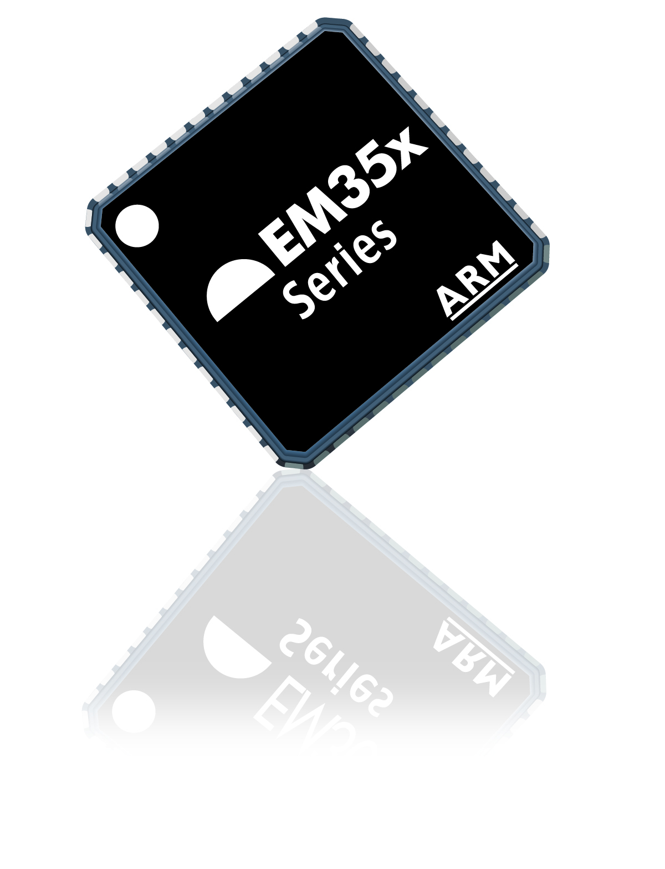
EM35x Series ZigBee System-on-Chip
Third generation ZigBee mesh networking semiconductor systems
Integrate and ARM Cortex-M3 processor and IEEE 802.15.4 RF transceiver
Industry leading performance, code density and power consumption
EM351 - supports ZigBee Home Automation and Network Coprocessor applications using EmberZNet PRO network protocol stack
EM357 - full support for all ZigBee PRO application profiles including Smart Energy 1.x
EM358x - full support for all ZigBee PRO and ZigBee IP applications including Smart Energy 2.0
New
Notes:
This slide highlights the main features of the EM351/EM357 products including:
ARM Cortex-M3 which can be used to run both the ZigBee software and customer applications
Integrated 2.4 GHz RF transceiver supporting IEEE 802.15.4
ZigBee is based on the 2003 release of IEEE 802.15.4
We do not currently support non-ZigBee protocols based on IEEE 802.15.4 on the EM351/357/358x (only ZigBee is supported today)
We do support ZigBee IP / SE 2.0 and we are a golden unit for ZigBee IP

Slide 4
Introducing EM358x
Market Strategy:
EM358x is an extension of the market leading EM35x family of ZigBee SoCs
Reduced BOM: Remove the need for external flash part (for bootloading)
Collapse design: Reduce the number of micros required in product designs
Complex applications: Provide more flash / ram for expanding applications
Product Roadmap/Portfolio:
EM358x expands the EM35x family to 7 parts total to cover a range of designs
Next generation products will be even more flexible
EM35x Variant | Flash | RAM | USB
EM3581 | 256kB | 32kB | No
EM3582 | 256kB | 32kB | Yes
EM3585 | 512kB | 32kB | No
EM3586 | 512kB | 32kB | Yes
EM3588 | 512kB | 64kB | Yes

Slide 5
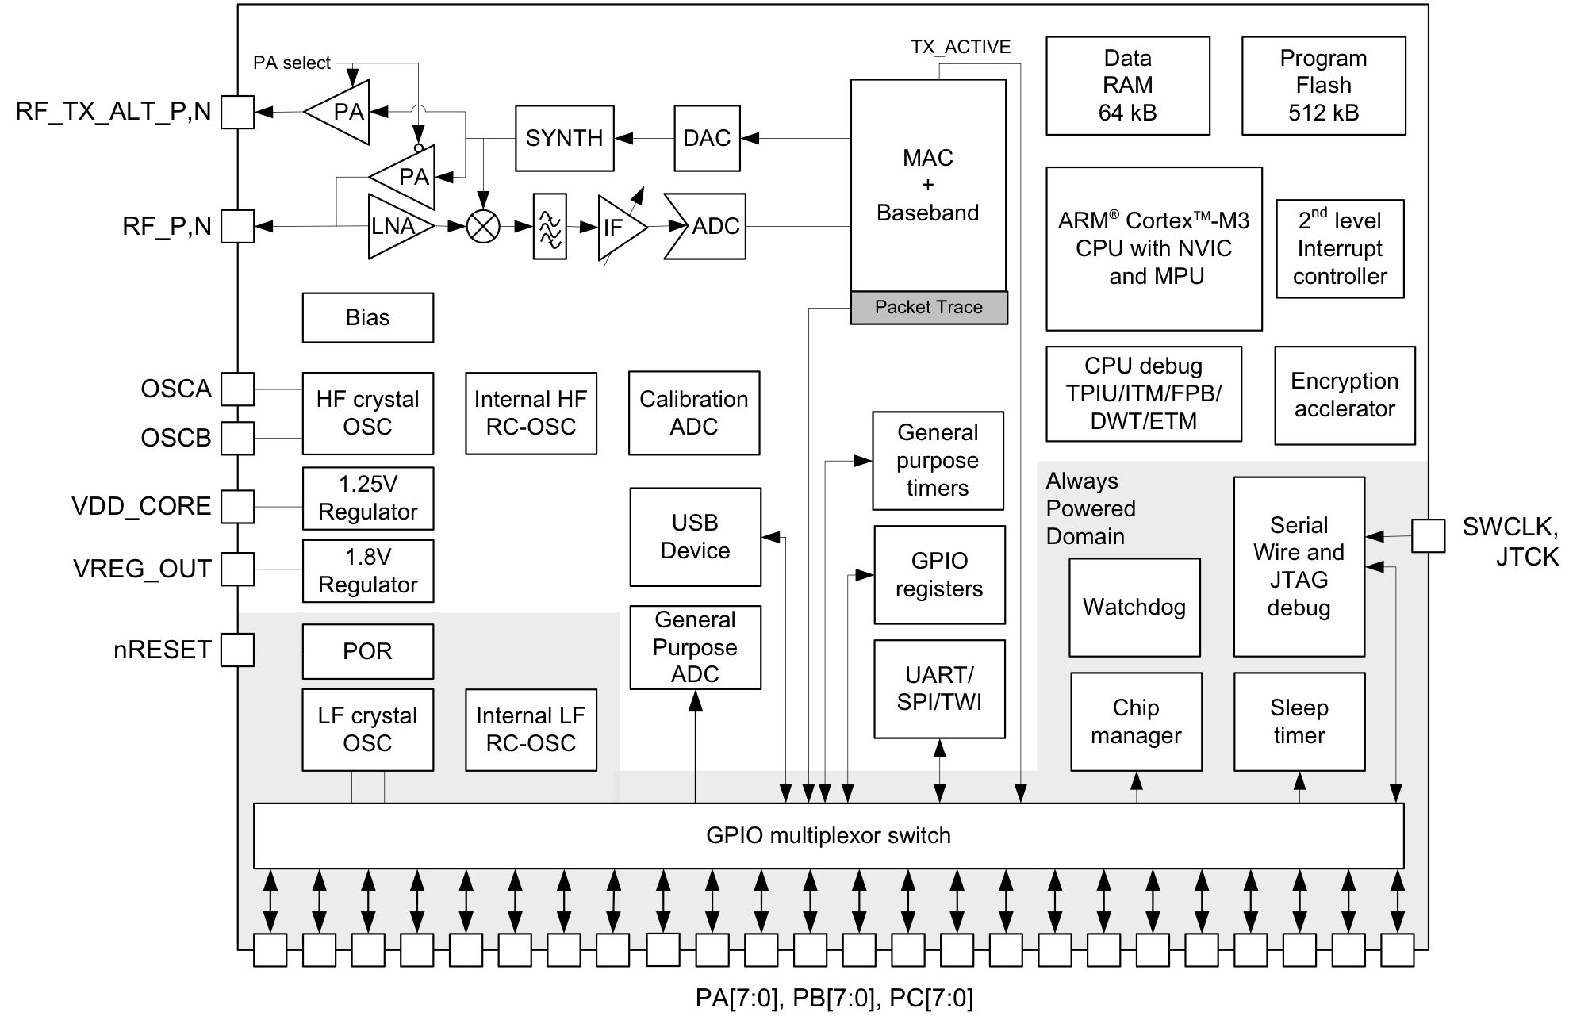
EM358x Features
Newest addition to the market-leading EM35x ZigBee SoC family
IEEE 802.15.4 transceiver
2.4GHz frequency band
Up to +8dBm output power
-102dBm sensitivity @ 250kbps
Lower MAC accelerator
AES128 encryption accelerator
32-bit ARM® Cortex™-M3
512/256kB flash
64/32kB RAM
High performance peripherals
14-bit ΣΔ ADC
Timers: Sleep, Watchdog, 4x General purpose
Serial ports: UART, SPI, I2C, USB

Slide 6
EM358x Enables
What can I do with extra Flash?
Remove the external flash part used for a bootloader image, store it on EM358x
Remove the application micro, put all of the application on EM358x
Build flash-hungry applications like Smart Energy 2.0, with room for expansion
Store more application data
What can I do with extra RAM?
Run larger memory-hungry applications like Smart Energy 2.0
Connect with more devices on larger networks
Support an RTOS running on EM358x
What can I do with USB?
Provide a simple application interface to an application micro
Provide a service port to a device
Simplify production programming

Slide 7
Which part does my customer need?
Flash / RAM (kB) | EM351 128 / 12 | EM357 192 / 12 | EM3581/2 256 / 32 | EM3585/6 512 / 32 | EM3588 512 / 64
Small proprietary ZigBee PRO application | ✔ | ✔ | ✔ | ✔ | ✔
ZigBee Home Automation 1.x end device | ✔ | ✔ | ✔ | ✔ | ✔
ZigBee Home Automation 1.x router | ✔ | ✔ | ✔ | ✔ | ✔
Network Coprocessor device (non-Smart Energy) | ✔ | ✔ | ✔ | ✔ | ✔
ZigBee Light Link 1.0 end device |  | ✔ | ✔ | ✔ | ✔
ZigBee Light Link router |  | ✔ | ✔ | ✔ | ✔
ZigBee Smart Energy 1.x NCP device |  | ✔ | ✔ | ✔ | ✔
ZigBee Smart Energy 1.x end device |  | ✔ | ✔ | ✔ | ✔
ZigBee Smart Energy 1.x router |  | ✔ | ✔ | ✔ | ✔
ZigBee Smart Energy 2.0 IP modem device |  | ✔ | ✔ | ✔ | ✔
ZigBee Smart Energy 2.0 end device or router |  |  | ✔ | ✔ | ✔
Integrated OTA image storage (ZHA) |  |  | ✔ | ✔ | ✔
Integrated OTA image storage (ZLL / ZSE) |  |  |  | ✔ | ✔
Full gateway device with USB |  |  |  |  | ✔

Slide 8
ZigBee Competition
 | Silicon Labs EM35x | TI CC2538 | Atmel Atmega RFR2 | NXP JN516x
Core type | Cortex-M3 | Cortex-M3 | RISC | RISC
Flash | 128-512kB | 128-512kB | 64-256kB | 64-256kB
RAM | 12-64kB | Up to 32kB | 8-32kB | 8-32kB
TX power | +8dBm max | +7dBm max | +3.5dBm | +2.5dBm max
RX sensitivity | -102dBm max | -97dBm max | -100dBm | -95dBm max
Link budget | 110dB max | 104dB max | 103.5dB max | 97.5dB max
RX current | 27mA (w/CPU) | 23mA (CPU idle) | 10.1mA (w/ CPU) | 17mA (no CPU)
TX current | 32mA (w/CPU) | 24mA (CPU idle) | 18.6mA (w/CPU) | 15mA (no MCU)
Sleep current (w/ RAM retained) | 0.8/1.25uA (w/ timer) / 0.4/1.0uA (no timer) | 1.3uA (w/ timer) / 0.4uA (no timer) | 1.5uA (w/ timer) / 0.75uA (no timer) | 1.5uA (w/ timer) / 1.02uA (no timer)
USB | Yes | Yes | No | No
Multi-Network | 1 radio on 2 PANs | Dual profile support | Multiple PAN filter | No
Local Storage Bootloader | Yes | Yes | No | No
Enhanced Security | Secure Bootloader | RSA HW acceleration
Other | Packet Trace |  | EEPROM Antenna diversity Adjust data rate | EEPROM Antenna diversity Time of flight

Slide 9
EM35x Key Product Strengths
Hardware
World Class RF performance → longer range/more reliable networks
Industry leading CPU performance → enables single-chip systems
Ultra-low standby current → up to 10 years of battery life
Software
Best-in-class ZigBee stack and application layer → reliable/scalable network
ZigBee Alliance certifiable reference application code → faster time to market
Tools
Unique packet trace capability enables full network analysis → fast debug
Simple graphical Ember AppBuilder interface → ZigBee certifiable applications
Technology leadership
Chair several ZigBee Alliance committees → driving next generation features
Leading the development of ZigBee IP → only open standard for 6LoWPAN
Notes:
The slides should be used to reinforce the idea that the value of the Silicon Labs ZigBee solution goes beyond the hardware. The software and tools are a big part of the product differentiation.

Slide 10
EM35x – More than a datasheet
Multi-Networks – Single EM35x connect to two ZigBee networks
Networks can be on different PAN IDs and different frequency channels
Example 1: Coordinator on ZHA network / End Device on ZSE network
Allows home network to access meter data for rate and usage information
Example 2: Coordinator on ZLL network / End Device on ZHA network
Allows a ZLL light bulb to be controlled by either both ZLL or ZHA networks
Secure bootloader – end-to-end security for upgrades
Bootload image is encrypted at the factory
Image is only decrypted when it is bootloaded into the device
Highly desired feature for Smart Energy networks
Module Partnerships
Module partners provide ZigBee hardware and software expertise to make adding ZigBee to a design easy for our customers
Each region / distributor should have their preferred ZigBee module partner

Slide 11
Why do we win with EM35x?
Market Leadership
Our customers know that we lead the ZigBee market
Our expertise and experience comes through in our products, tools, support
Our customers know they can build successful products
Best in class silicon
We match and beat the competition in many areas, especially RF performance
Superior ZigBee PRO software stack
Robust, scalable networking stacks come from years of testing, experience
No-one has more experience certifying ZigBee software stacks and applications
Unique approach to tools
Ember Desktop is unique – no-one else has such powerful debugging tools
Our tools start with our chip design, leading to rich data about network activity
Ember AppBuilder ensures that customers build interoperable products easily

Slide 12
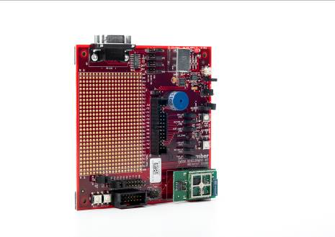
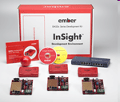
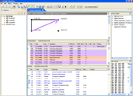
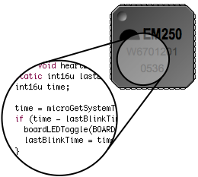
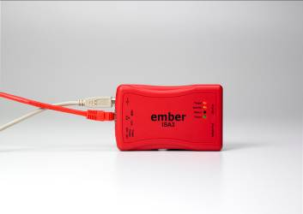
EM358x Development Tools
Adding EM358x to existing EM35x Development Kit is easy!
Upon launch of EM358x, all new EM35x Development kits will contain EM358x
EM358x uses all the same familiar tools;
Ember Desktop
Debug Adapter
Packet Trace Port
Ember Desktop provides a macroscopic view of the entire network from single console
Debug Adapter provides a high-speed back-channel link between Desktop Network Analyzer and node
Packet Trace Port reaches deep inside the silicon to trace packets and to monitor and control the application.
Notes:
This slides highlights the benefits of the development tools that are provided with the Ember ZigBee solution. The key message is that the tools enable a unique programming and network debugging environment. The customer has full visibility into the network to enable development and debugging of complex networks. The Ethernet backchannel allows networks to be debugged remotely across a standard local area network (LAN). Results in a higher quality more reliable product and faster time to market.
Packet Trace Port—hardware based packet monitoring records each packet transmitted or received and makes it available through a simple two wire serial port
Debug Adapter—provides a bridge between the Packet Trace Port and the Desktop Network Analyzer using a standard Ethernet connection. Can be powered by PoE to reduce wiring required.
Ember Desktop —GUI that allows the user to view the activity of any node in the network and trace the activity through the applications and network layers down to the packets transferred over the network. Enables fast debugging of network activity.
Development Kits—contain all of the hardware/software required for a customer to develop a simple 2-3 node network.
- Hardware: Radio control modules (3), breakout board (3), debug adapter (3), variety pack of EM35x modules, 8-Port switch with POE, all cables necessary to connect the equipment
- Software: Desktop Network Analyzer, Ember AppBuilder, IAR Embedded Workbench (either 30-day trial or 1-year license)
EM35x NCP Add-on Kit—contains additional hardware to use the EM35x as a Network Co-Processor (NCP)
- Hardware: EM35x NCP breakout board, EM35x module, STM32 host module, battery pack
EM358x hardware includes an EM3588 module and breakout board (with USB).
This will be available as separate parts that can be added to an EM35x Development Kit
New EM35x Dev Kits after launch will include some EM3588 modules and breakout boards.

Slide 13
EM358x Availability
Currently running Beta program with 10 key customers
ZigBee PRO stack, tools, EM358x chips and development kit hardware
EmberZNet PRO 5.0 Software release – April 2013
Supports EM358x platform including USB
Introduces Local Storage Bootloader (OTA Bootloader using on-chip flash)
Introduces Secure Bootloader feature
EM358x release schedule
Pre-Production – May 2013
Initial Production – June 2013 → launch July 2013
Full Production – September 2013
Collateral
EM358x datasheet available under NDA until launch
These slides, more to come with launch

Slide 14
Summary
New expanded range of the most popular ZigBee SoCs
Up to 512kB Flash → larger applications or eliminate external Flash / 2nd micro
Up to 64kB RAM → larger applications, larger networks, IP networking
Optional USB → application interface / service port / production bootload
Match customer requirements to the right EM35x product
ZigBee profile: Home Automation, Smart Energy, Light Link
System partitioning: system-on-chip or network coprocessor
Application: Battery powered end device, router or application gateway
How to sell EM35x versus ZigBee competitors
Unique tools → faster time to market & higher quality products
Market leading software → reliability, robustness, scalability, interoperability
EM35x family of parts for every ZigBee design

Slide 15
Call to Action
Introduce EM358x to existing ecosystem
Smart Energy customers: Meters, displays, hubs that need to connect to HAN
Smart Energy customers who are considering Smart Energy 2.0
Home Automation customers who want to eliminate external Flash
Any customer looking to reduce the number of micros in their device
Identify new opportunities in key market segments
Home automation market drivers (e.g. Comcast, TimeWarnerCable, Lowe’s)
Smart energy ecosystem drivers (e.g. government regulators, utilities)
Contact us for assistance:
US / APAC: Thomas Barber (thomas.barber@silabs.com)
EMEA: David Egan (david.egan@silabs.com)

Slide 16
www.silabs.com/Wireless

Slide 17
Silicon Labs ZigBee SoCs
 | EM351 | EM357 | EM3581 | EM3582 | EM3585 | EM3586 | EM3588
Core type | Cortex-M3 | Cortex-M3 | Cortex-M3 | Cortex-M3 | Cortex-M3 | Cortex-M3 | Cortex-M3
Flash | 128kB | 192kB | 256kB | 256kB | 512kB | 512kB | 512kB
RAM | 12kB | 12kB | 32kB | 32kB | 32kB | 32kB | 64kB
USB | No | No | No | Yes | No | Yes | Yes
Sleep current | 0.8uA / 0.4uA | 0.8uA / 0.4uA | 1.25uA / 1.0uA | 1.25uA / 1.0uA | 1.25uA / 1.0uA | 1.25uA / 1.0uA | 1.25uA / 1.0uA
Max TX Power | +8dBm | +8dBm | +8dBm | +8dBm | +8dBm | +8dBm | +8dBm
Max RX Sensitivity | -102dBm | -102dBm | -102dBm | -102dBm | -102dBm | -102dBm | -102dBm
Package | QFN-48 | QFN-48 | QFN-48 | QFN-48 | QFN-48 | QFN-48 | QFN-48

Slide 18
EmberZNet PRO Software
Complete ZigBee PRO Feature Set Stack (Most Deployed ZigBee Stack!)
True mesh routing
Stochastic Addressing
Fragmentation
Standard Security
Frequency Agility
PAN ID Conflict Resolution
Many-to-one routing
Ember ZNET PRO
Enhanced Features
Asymmetric links
Intelligent table management
Single stack for end point, router & coordinator
Certifiable Reference Applications
Certified HA, SE & LL Profile applications
Full ZigBee Cluster Library (ZCL) implementations
Flexible APIs
Ember AppBuilder Tool
Customer Applications
Development Tools
Reference Apps
Flexible Utilities
Full-featured bootloader options
Robust Mfg test libraries
Powerful debug options
Utilities
Ember ZNet PRO Stack
EM351/EM357
Notes:
This slide highlights the main feature of the EmberZNet PRO protocol stack software. The EmberZNet PRO stack is the most robust, scalable and mature ZigBee PRO stack available. The first seven features listed on the left side are all standard ZigBee features. The last three features are unique to the EmberZNet PRO stack from Silicon Labs.
The asymmetric link feature ensures the link is good in both directions before connected two nodes. This is critical in networks with devices from multiple vendors whose transmit output power and receive sensitivity are different.
Intelligent table management enables denser networks by forcing the routers to chose neighbors that cannot communicate directly. This enables messages to get out of dense networks (like a building utility center with hundreds of electric meters) with fewer hops which improves the bandwidth and latency of dense networks.
Unlike other ZigBee solutions, the EmberZNet PRO stack can be configured as an end point, router or coordinator at run time. The allows for more flexibility in both the device and network design.
ZigBee PRO stack (EmberZNet PRO)
These are all standard features of the ZigBee PRO stack.
True mesh routing—routes chosen my link quality. Network self-heal if a route breaks.
Stochastic addressing—enables the network to scale to thousands of nodes
Fragmentation—enables support of messages longer than the maximum payload for a given burst
Standard security—128-bit security is standard for ZigBee
Frequency agility—allows an entire network to switch frequency if there is a new source of interference
PAN ID conflict resolution—enables selection of a new PAN ID if there is a conflict with another network
Many-to-one routing—reduces network traffic by enabling a single broadcast message to multiple end-points.
Certifiable Reference Applications
Solutions for Home Automation (HA), Smart Energy (SE) and Light Link (LL) profiles available.
ZCL = Zigbee Cluster Library → basic functions that are used to build ZigBee applications profiles
ZCL can be used to develop ZigBee standard profiles that are not currently supported by Silicon Labs or to develop custom applications profiles
Ember AppBuilder tool is a simple graphical interface that enables quickly building ZigBee compliant applications (see later slide for more details).
Flexible Utilities
Full-featured bootloader—enables local or over the air (OTA) reprogramming of the stack and applications code
Robust manufacturing test library—allows the same software image to be used for manufacturing test and normal operation
Powerful debug options—enables full visibility into network for debug and testing (see “Development Tools” slide for more details)

Slide 19
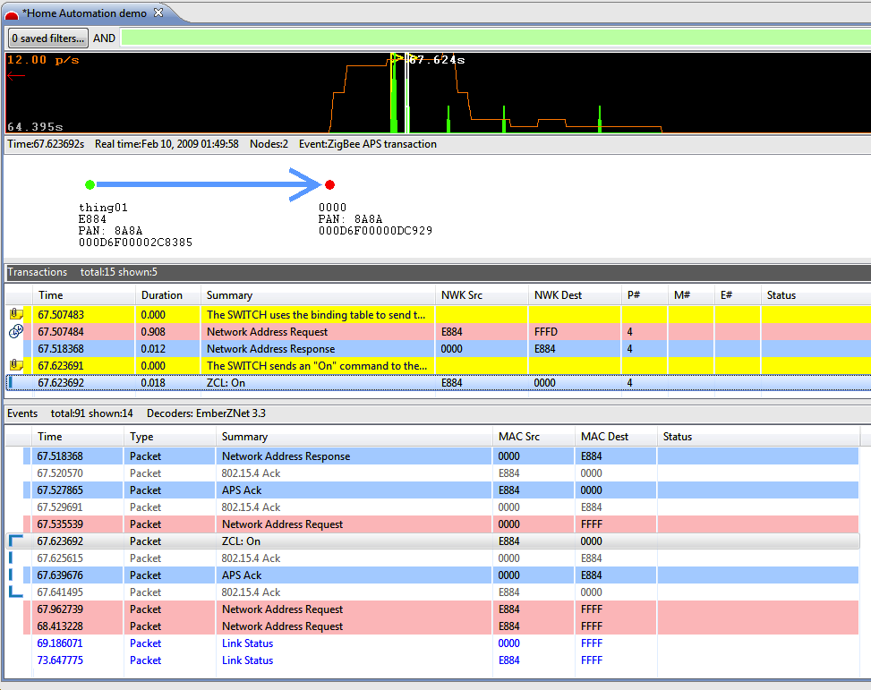
Ember Desktop
True network-level development platform:
Network-wide view of all packet activity
Decodes all standard ZigBee ZCL commands/activity
Correlates network traffic into higher-level events
Leverages Ethernet out-of-band “backchannel” to provide true activity
Custom decoding and filtering options
Online Video Demos:
http://www.silabs.com/products/wireless/zigbee/Pages/zigbee-training-videos.aspx
Notes:
This slide highlights the features of the Ember Desktop. Ember Desktop enables fast network debugging by providing multiple views of the network activity allowing users to quickly spot time periods of interest, view the transactions both graphically and in text and look at the packets transferred during each transaction.
Filtering can be applied to each level of the activity to allow users to quickly identify nodes, transactions, packets and other parameters of interest.
The top section of the screen (mostly black) shows the overall network activity. This can be used to quickly identify time periods of interest (heavy activity, light activity, etc)
The second section (with the arrow) graphically illustrates the type of transaction being highlighted (in this case a unicast from “thing01” to “0000”)
- This section can be customized to show details about the location and or relationship between the nodes
The third section is a transaction level view of the activity for the given time period. The transaction view interprets the ZigBee cluster activity and displays the activity in more descriptive terms.
The Fourth section is a packet level view of the activity. This shows all of the packet level transfers for the given transaction.

Slide 20
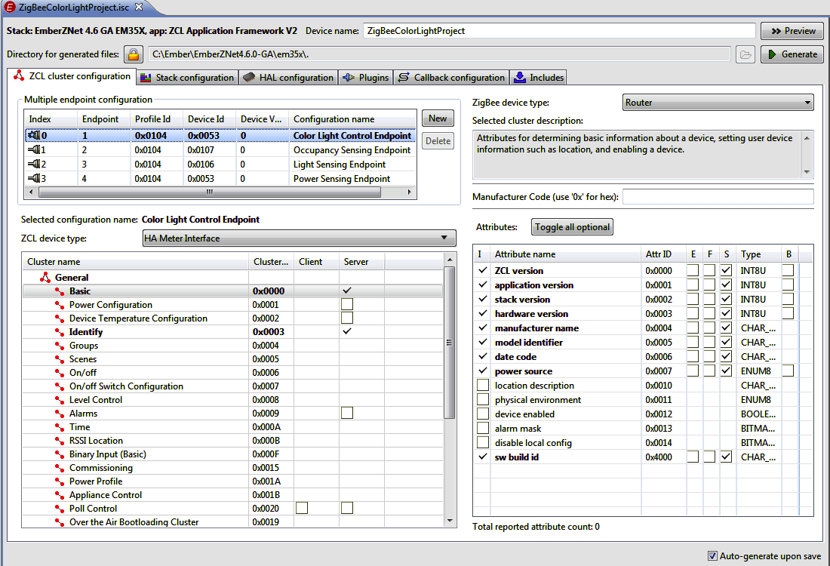
Ember AppBuilder
Generates complete, ready for certification “template application”
Enables “ZigBee Certified Products” based on standard application profiles
Simple graphical interface to select device and network parameters
Device type, commands and behaviors
Automatically includes the ZigBee Cluster Library (ZCL) attributes and reporting
Network forming and joining behaviors
Security modes and operation
Easy vendor customizations
Simply add vendor-specific code to complete the application
ZigBee Cluster Library
Application Profiles
Others…
Closures
Commercial Building Auto.
Safety & Security
Lighting
Others…
Measurement & Sensing
HVAC
Home Automation
AMI
General
Notes:
This slide highlights the benefits of the Ember AppBuilder tool.
The Ember AppBuilder tool provides a graphical interface allowing customers to quickly configure one of the existing applications profiles (Smart Energy, Home Automation or Light Link) or build new applications profiles using the ZigBee Cluster Library (ZCL). The Ember AppBuilder enables fast/easy development of products ready for ZigBee Certified Product testing.
The Ember AppBuilder tool also provide a graphical interface for configuration of the network and each device in the network.
The output from the Ember AppBuilder tool is source code the can be compiled to run either on the EM351/57 or another host processor. Customers can easily add their own device specific code into the Ember AppBuilder output to create complete applications.

